Slide 1

Intro: Files, BASH and Git + Markdown
Ádám T. Kocsis
Friedrich-Alexander-Universität Erlangen-Nürnberg
2023-08-21
Ádám T. Kocsis

Slide 2
Why?
and GitHub

Slide 3

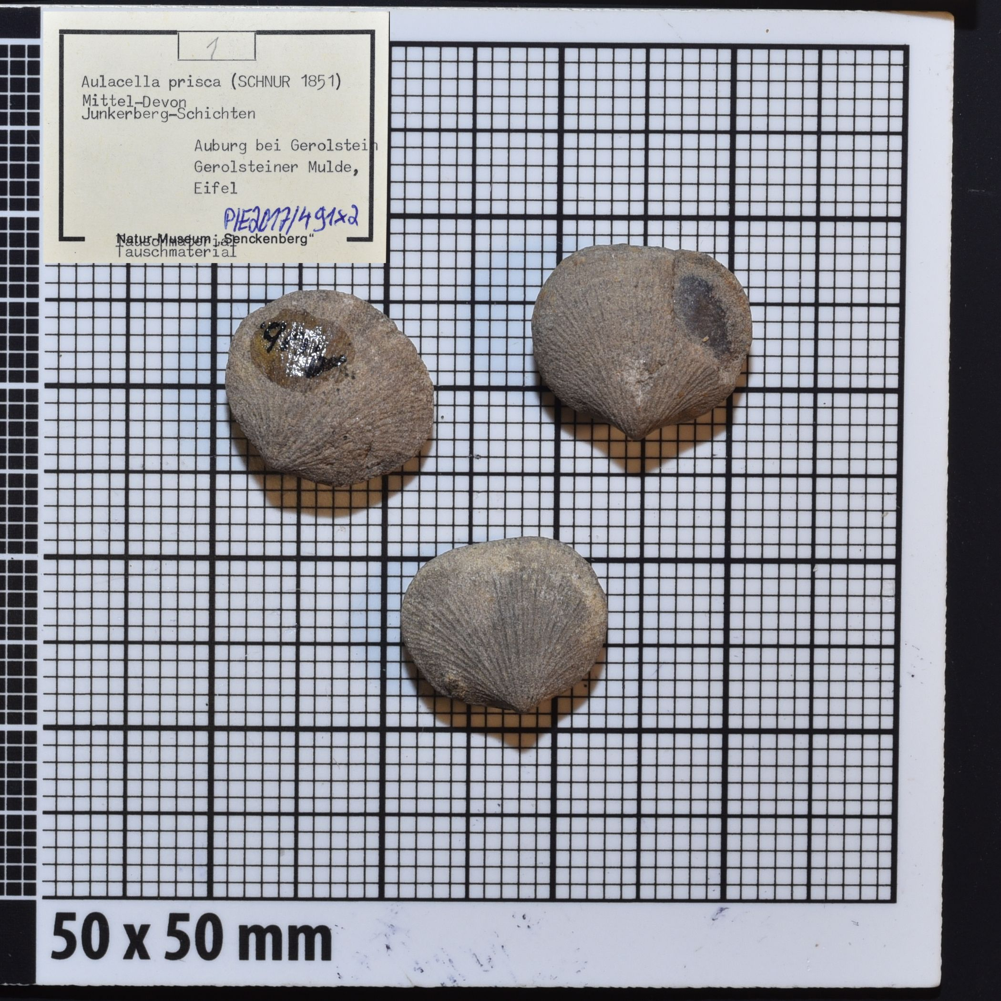
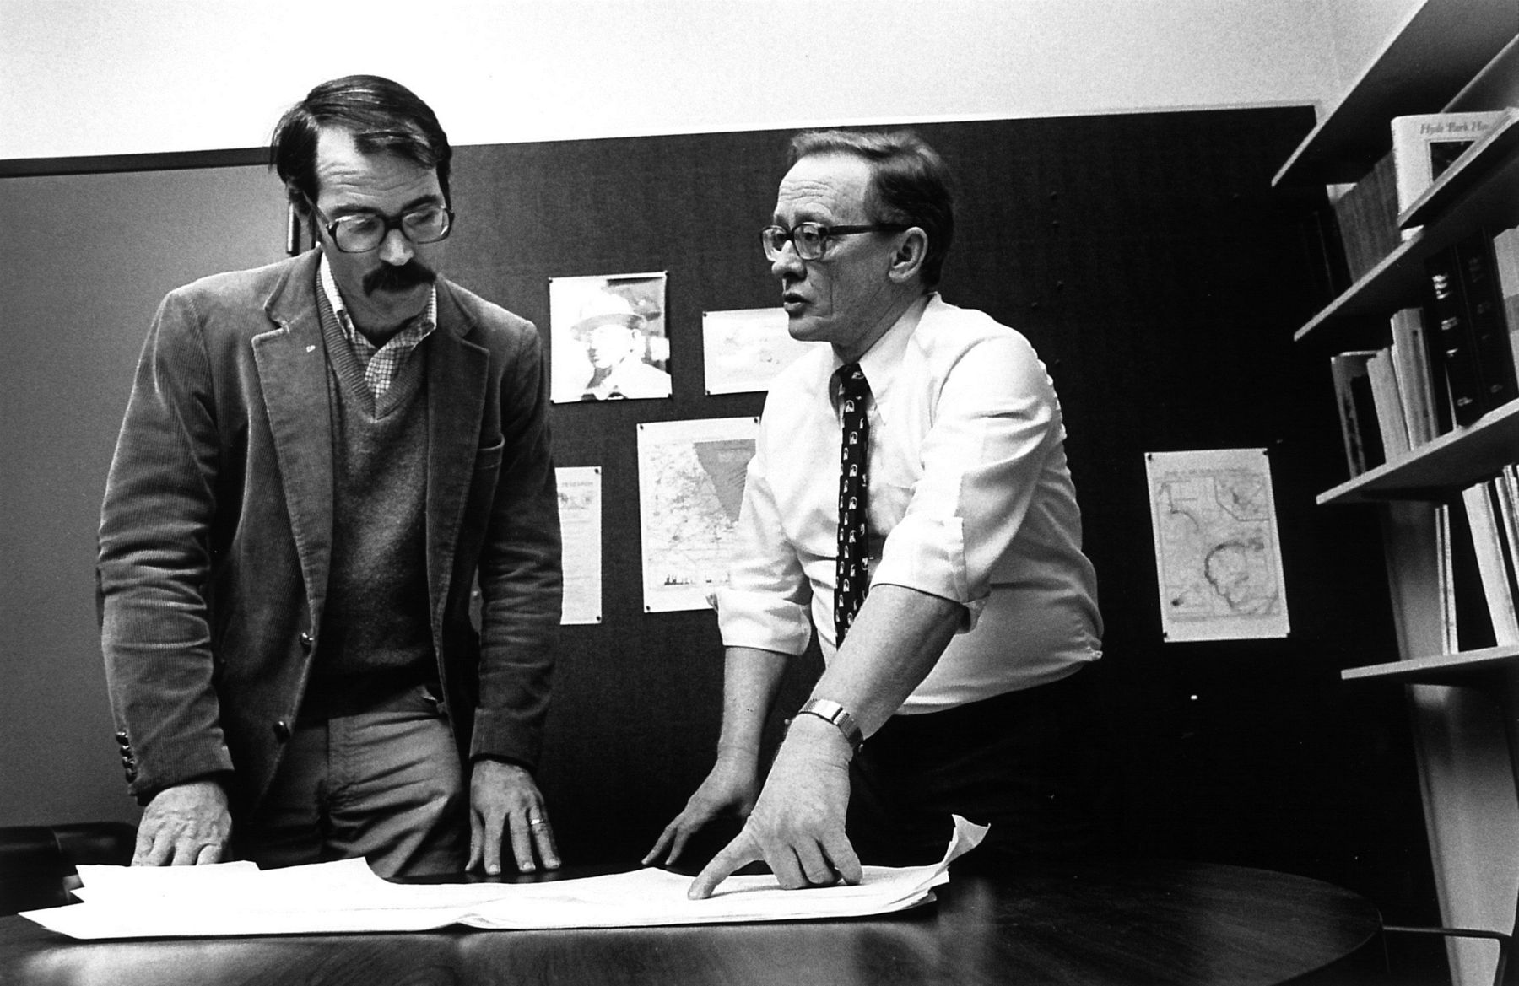
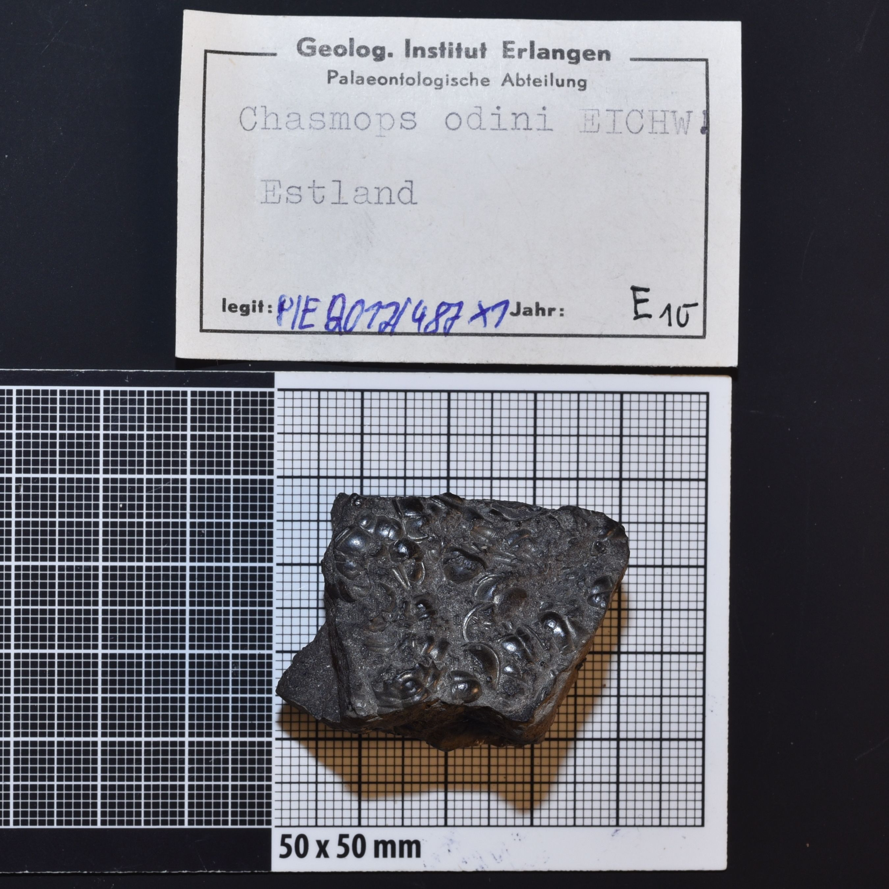


Paleontological data in the 21st century
We have gone a long way…
Collectors only
-1960s
Pioneers
1960-1990/2000
Community of database-based research

Slide 4

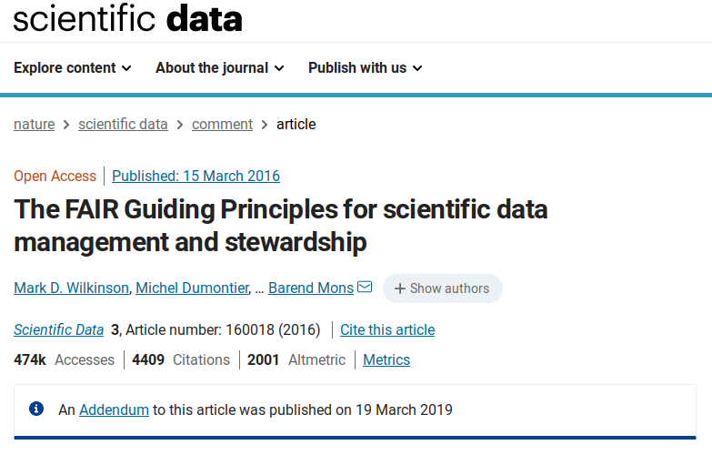

Being FAIR
A standard way to publish data and dat-based research.
Findable
Accessible
Interoperable
Reproducible
www.go-fair.org

Slide 5
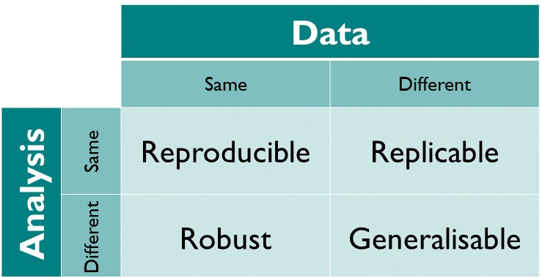
Reproducibility
The foundation of the scientific experiment
Source: The Turing Way: https://the-turing-way.netlify.app/
Can you reproduce the exact results that you acquired 5 years ago?
If you cannot reproduce what you have done, how can other people?

Slide 6
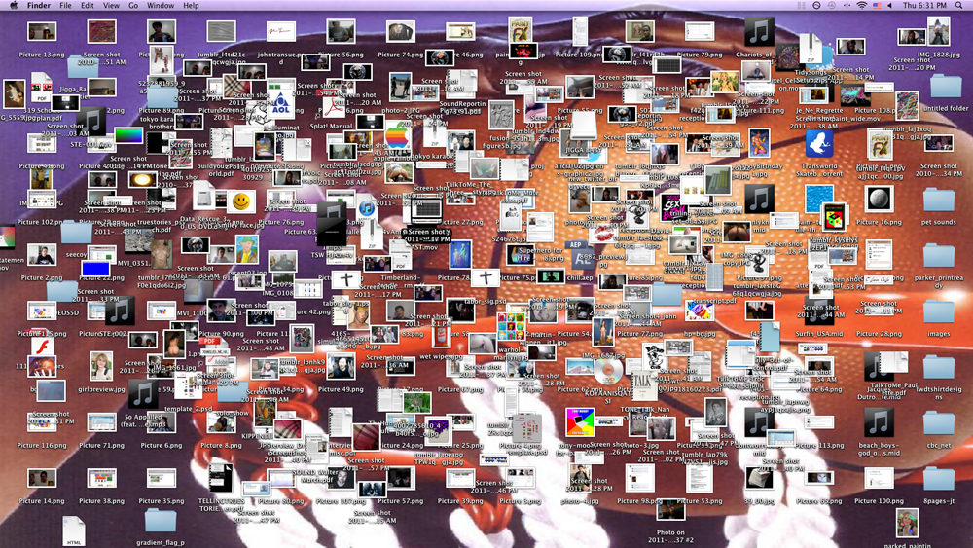
Avoid this at all costs…
Do not keep things on your desktop!

Slide 7
Overall file management
Suggestions
Overall file management
Keep all your stuff together (separate partition!)
Logical hierarchy
Make it portable (Windows!)
Regularly spend time on organizing and cleaning files
Naming and grouping: self-explanatory – make it for somebody else (you!)
Try to avoid spaces in paths
Cloud backups!

Slide 8
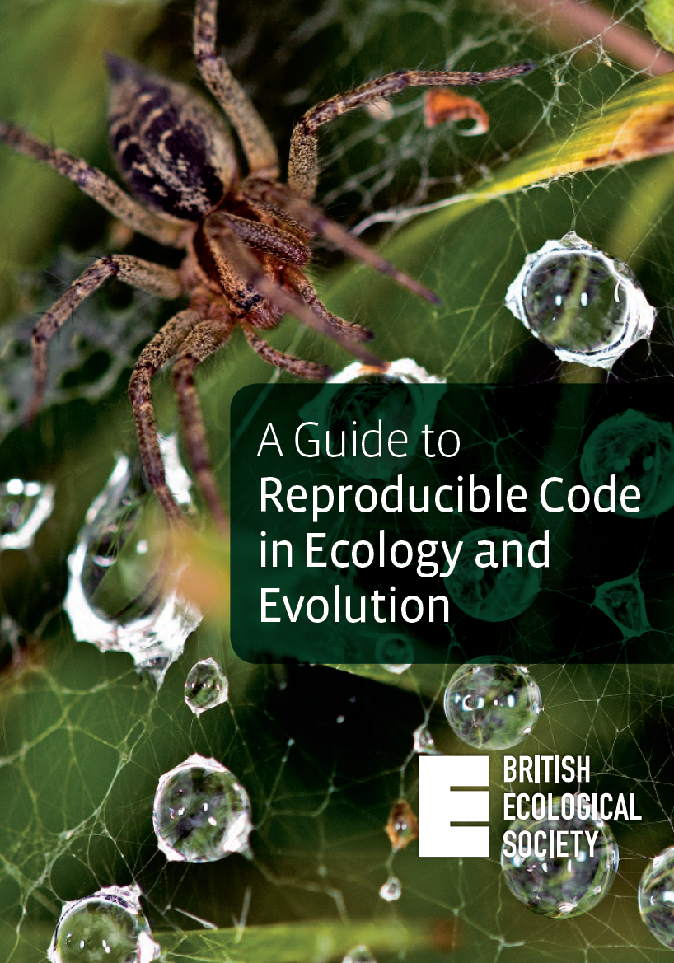
Reproducibility is your main goal!

Slide 9
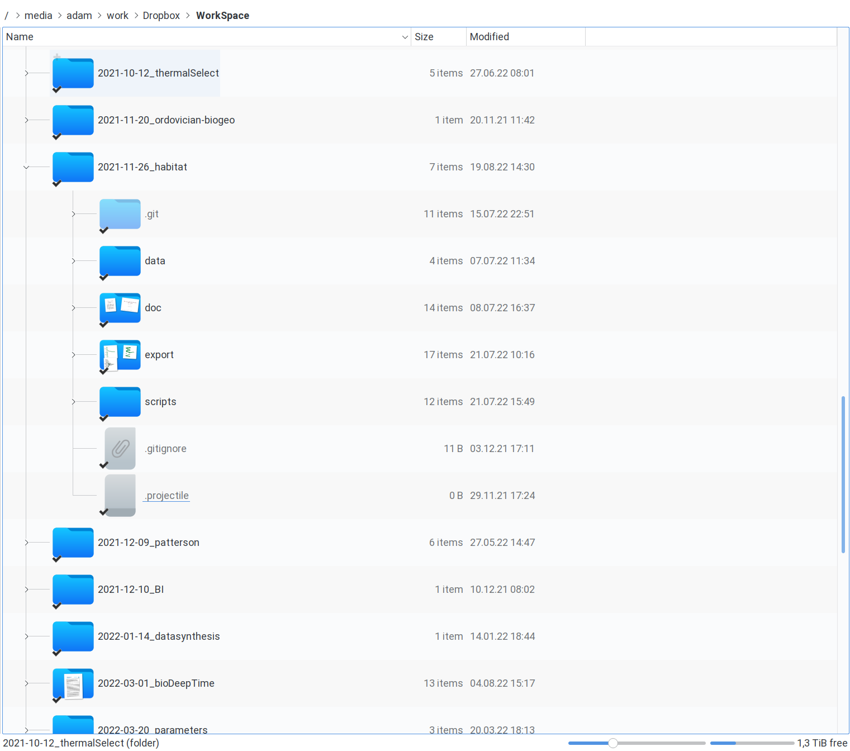
Suggestions
Keep all your projects separate!
Use the same project structure:
Input Data (data)
Computer code (code/scripts)
Written documents (doc)
Calculation output (export/output)

Slide 10
About files…

Slide 11
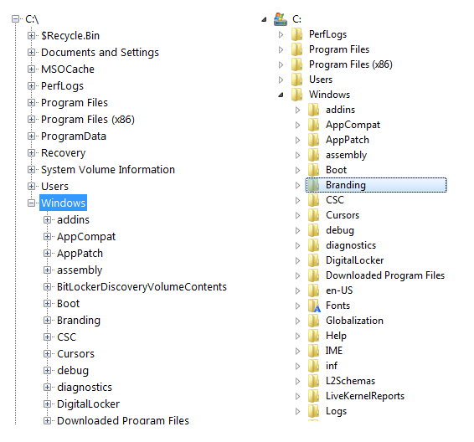
The Windows file system
Files are data items on storage devices
Paths use the characteristic backslash \ character to depict nestedness
Directories are called “Folders”
File format: filename.ext
Total path to “Branding”:
C:\Windows\Branding
Case insensitive!

Slide 12
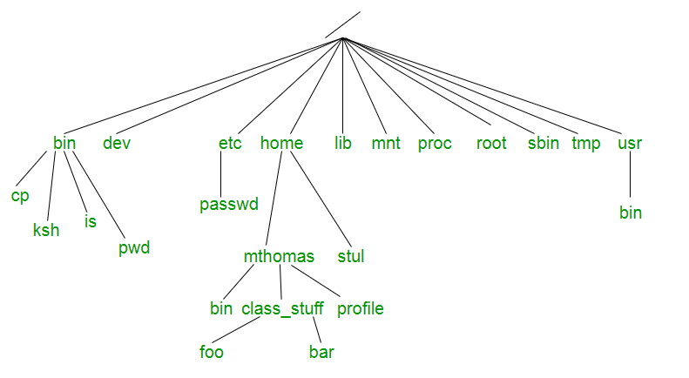
The UNIX file system
Shared for UNIX and UNIX-like systems (GNU/Linux, macOS, Android)
Concept: everything in the computer is represented by a file
Nestedness coded with forward slash : /
File format can be anything
Complete path to “bar”
/home/mthomas/class_stuff/bar
Case sensitive!

Slide 13
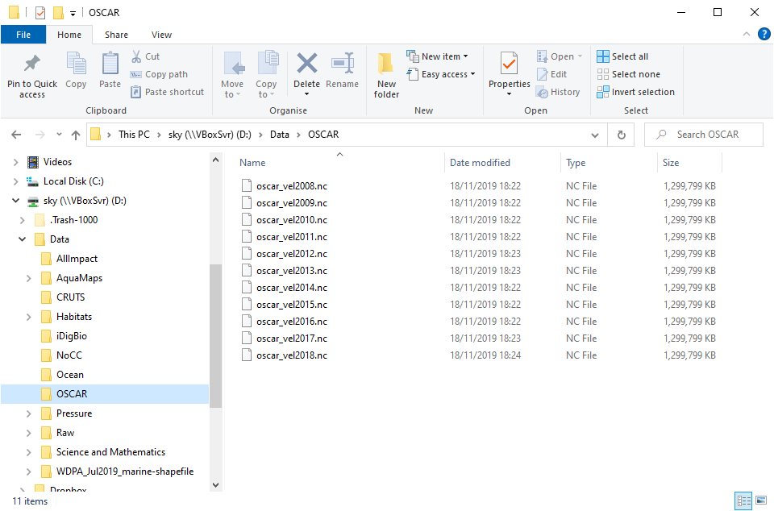
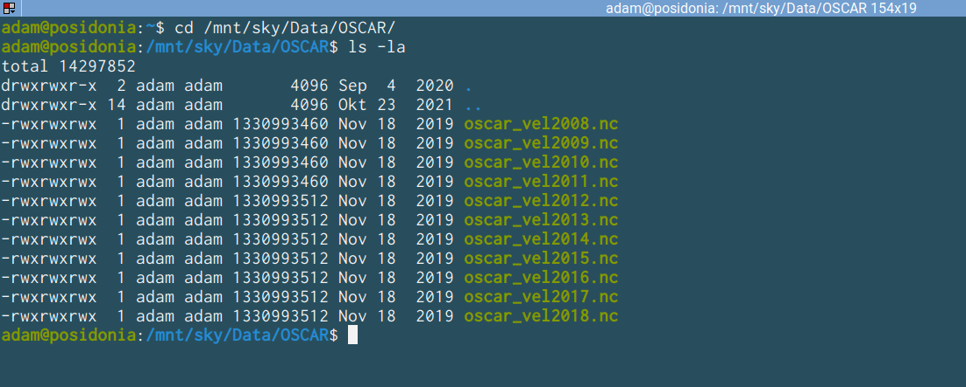
Two main options:
Graphical User Interface (GUI)
Command Line Interpreter (CLI)
Super simple + mouse
Visually appealing
“Novice-friendly”
Steeper learning curve
Automation
Keyboard-only “Expert-friendly”

Slide 14
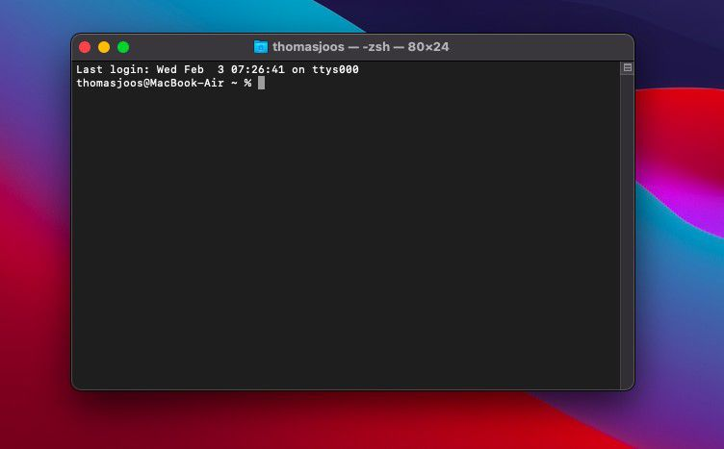
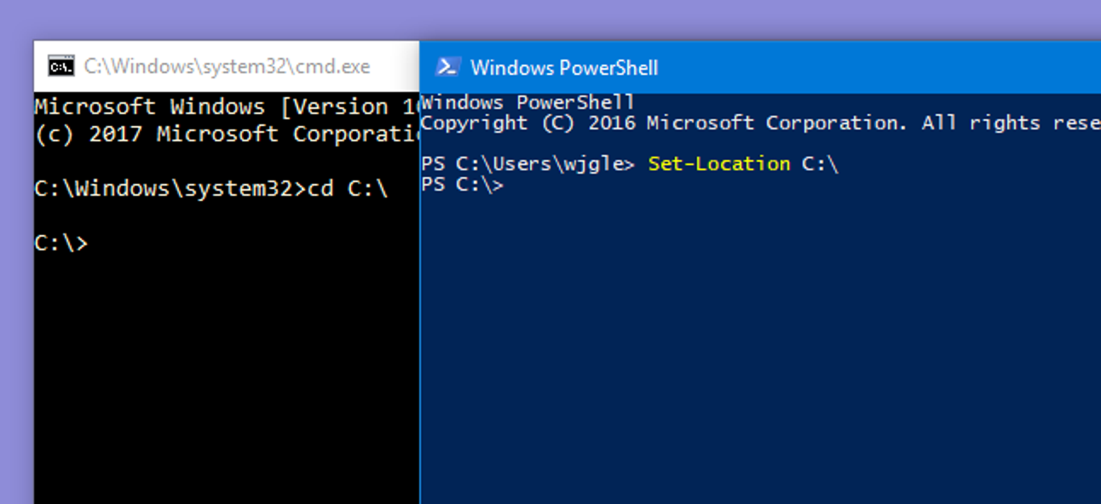
Terminal emulators
Mac (zsh or bash)
Every OS has one
Graphical applications that run a program called the “shell”: an interpreter program that translates instructions
Console applications can be run with the shell
Automation
Program building
Scientific calculations
Shells are programmable
Windows (cmd and powershell)

Slide 15


The BASH shell
Ubiquitous
Most frequently used on servers and clusters
UNIX-native: most programming systems use UNIX-like paths – even on Windows!
Mac: have it, z shell (zsh) is almost the same
Windows: a simplified version is available with git (git bash)
https://git-scm.com

Slide 16
Installing git for Windows
and GitHub

Slide 17
BASH essentials
Most important functions and browsing directories

Slide 18
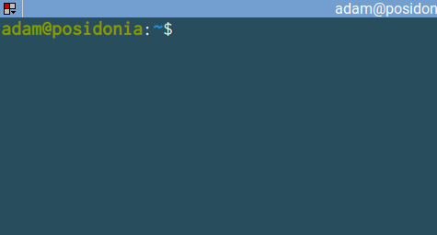
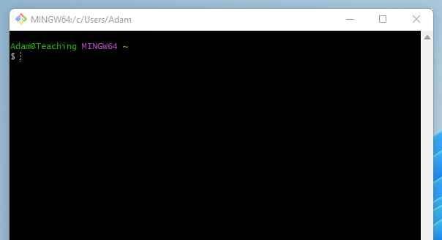
The prompt
User input expected (typing)
Looks different on all, but there are conventions:
user@host
~: is shorthand for user home
$: means normal user mode
OS: Ubuntu 20.04
Terminal Emulator: Terminator
Shell: BASH
OS: Windows 11
Terminal Emulator: MinTTY
Shell: Git-BASH

Slide 19
The prompt
User input expected (typing)
Looks different on all, but there are conventions:
user@host
~: is shorthand for user home
$: means normal user mode
user
host
~ (tilde): user home directory

Slide 20
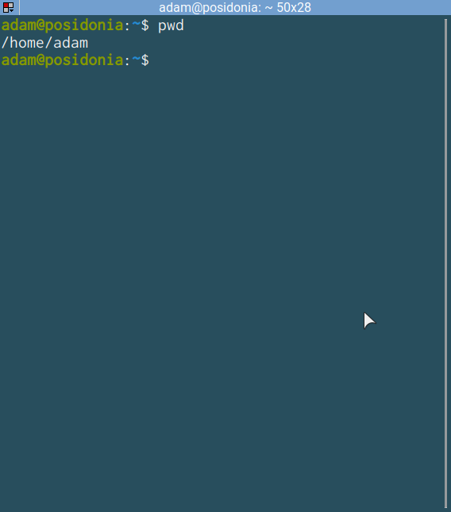
pwd
Return path to current directory

Slide 21

mkdir⎵<name>
Create a directory
space
No output to the console: no error occurred (directory was created)

Slide 22
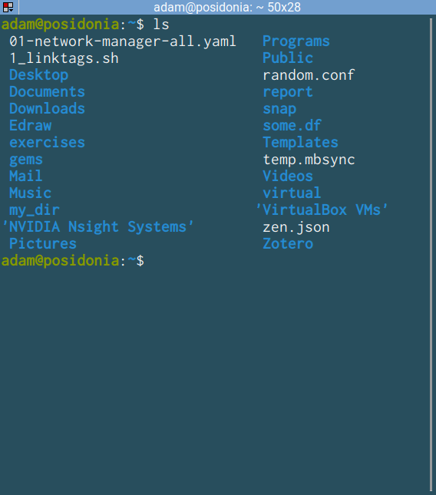
ls
List directory contents
Returns a list of entries (both normal files and directories) – can be colored
Note the quotes around entries with spaces in them!

Slide 23
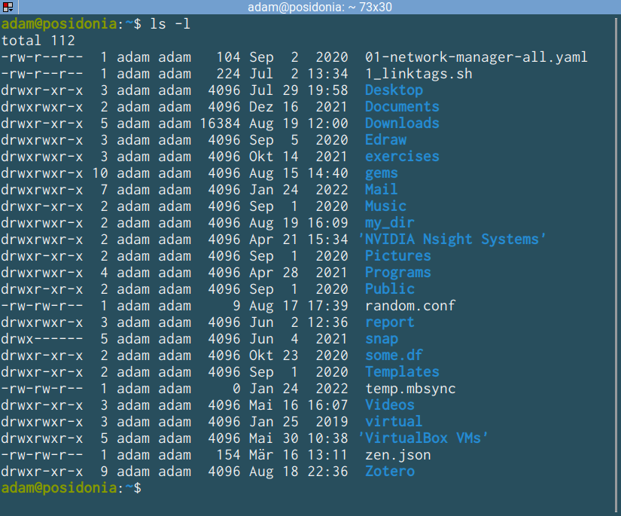
ls⎵-l
List directory contents (with option l)
Long output, includes attributes
d:directory
permissions
owner
size (bytes)
modification
name

Slide 24
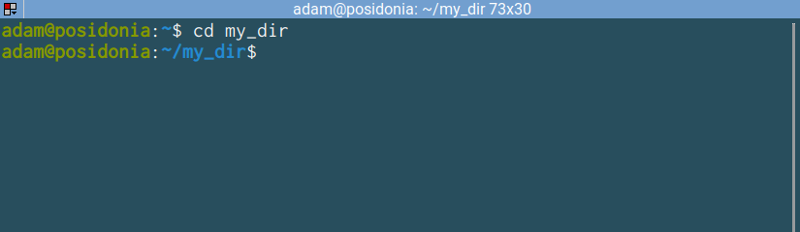
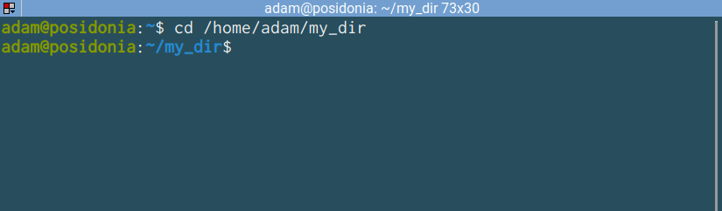
cd⎵<path_to_directory>
Go to a directory
Can be relative or absolute!

Slide 25
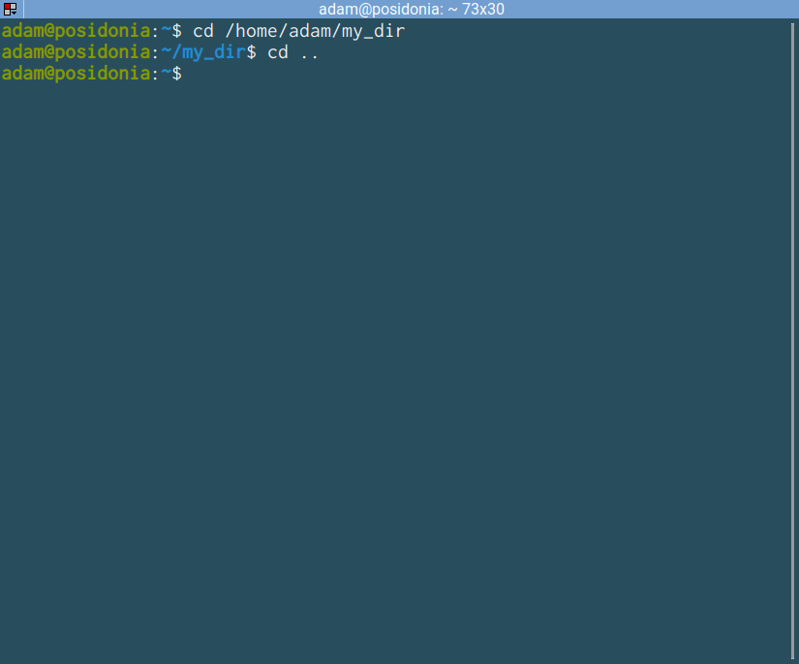
cd⎵..
Go to parent directory
.. (dot dot) is a placeholder for the parent of the current directory (one up in the hierarchy)

Slide 26
Exercise (5 minutes)
Create this directory structure using the combinations of the previous commands!
fossils
molluscs
brachiopods
vertebrates
gastropods
bivalves
reptiles
birds
mammals

Slide 27
Exercise (5 minutes)
Create this directory structure using the combinations of the previous commands!
fossils
Hints
use <TAB> completion (try <TAB> <TAB> to see multiple solutions)
use <UP> and <DOWN> to search command history for already given commands
molluscs
brachiopods
vertebrates
gastropods
bivalves
reptiles
birds
mammals

Slide 28
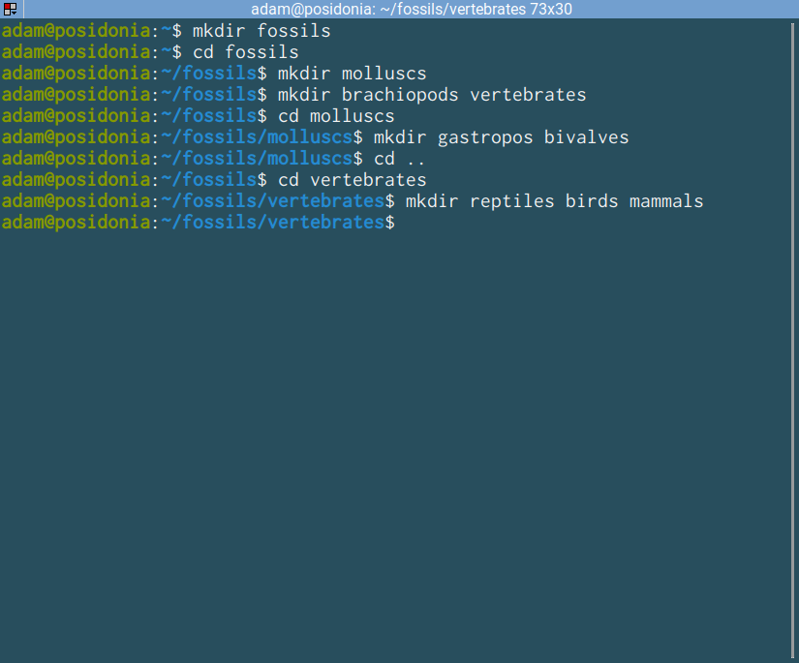
Solution 1 – changing directory
current directory
Parent (whatever)
fossils
molluscs
brachiopods
vertebrates
gastropods
bivalves
reptiles
birds
mammals

Slide 29
Solution 1 – changing directory
Parent (whatever)
fossils
molluscs
brachiopods
vertebrates
gastropods
bivalves
reptiles
birds
mammals

Slide 30
Solution 1 – changing directory
Parent (whatever)
fossils
molluscs
brachiopods
vertebrates
gastropods
bivalves
reptiles
birds
mammals

Slide 31
Solution 1 – changing directory
Parent (whatever)
fossils
molluscs
brachiopods
vertebrates
gastropods
bivalves
reptiles
birds
mammals

Slide 32
Solution 1 – changing directory
Parent (whatever)
fossils
molluscs
brachiopods
vertebrates
gastropods
bivalves
reptiles
birds
mammals

Slide 33
Solution 1 – changing directory
Parent (whatever)
fossils
molluscs
brachiopods
vertebrates
gastropods
bivalves
reptiles
birds
mammals

Slide 34
Solution 1 – changing directory
Parent (whatever)
fossils
molluscs
brachiopods
vertebrates
gastropods
bivalves
reptiles
birds
mammals

Slide 35
Solution 1 – changing directory
Parent (whatever)
fossils
molluscs
brachiopods
vertebrates
gastropods
bivalves
reptiles
birds
mammals

Slide 36
Solution 1 – changing directory
Parent (whatever)
fossils
molluscs
brachiopods
vertebrates
gastropods
bivalves
reptiles
birds
mammals

Slide 37
Solution 1 – changing directory
Parent (whatever)
fossils
molluscs
brachiopods
vertebrates
gastropods
bivalves
reptiles
birds
mammals
How to check?

Slide 38
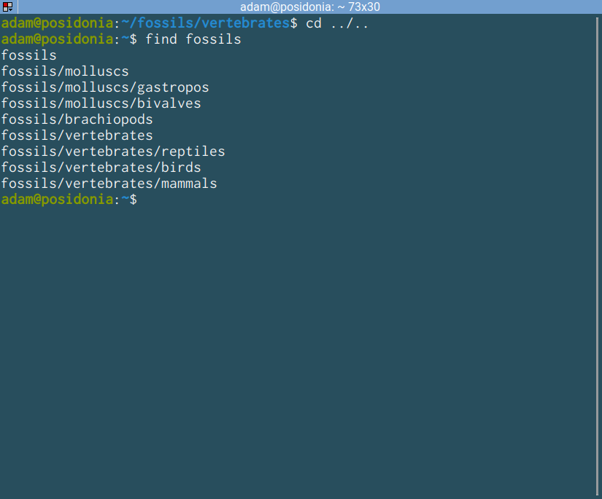
find⎵<path to directory>
Recursive listing
1. Go back to the parent
2. Use find there!
parent of parent
Parent (whatever)
relative paths
fossils
molluscs
brachiopods
vertebrates
gastropods
bivalves
reptiles
birds
mammals

Slide 39
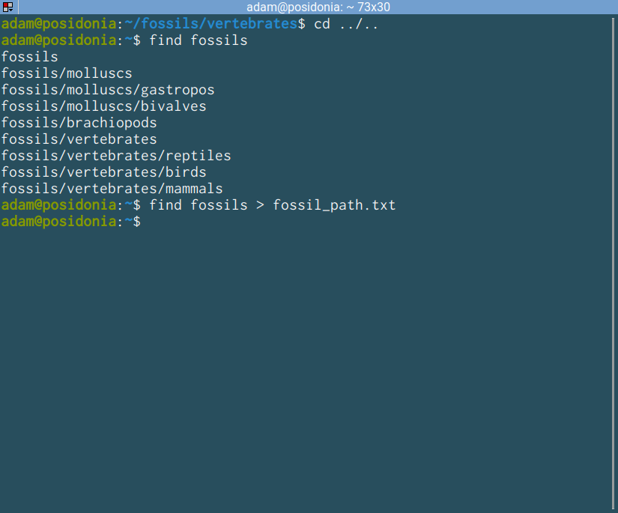
find⎵<path>⎵>⎵<path_to file>
Angled bracket or chevron
Output redirection
Whatever was output to the console is now in a new file!
Parent (whatever)
fossils
molluscs
brachiopods
vertebrates
“>” Will overwrite existing files!
gastropods
bivalves
reptiles
birds
mammals

Slide 40
Suggested nomenclature
( ): Parenthesis (open and close)
[ ]: Bracket (open and close)
{ }: Brace (open and close)
< >: Chevrons (left and right)

Slide 41
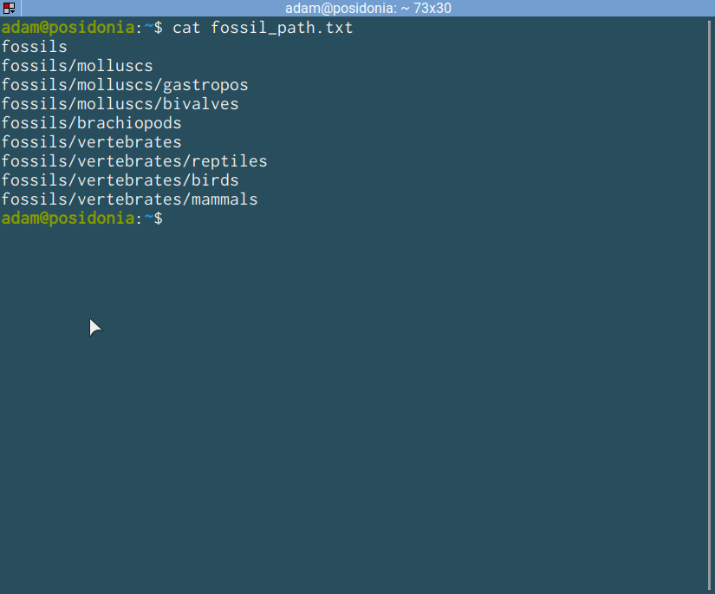
cat⎵<path to file>
Display contents of file
Exactly as it was output to the console

Slide 42
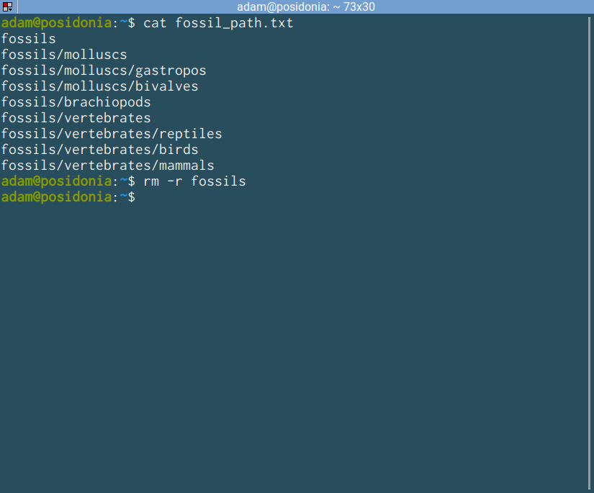
rm⎵-r⎵<path to dir>
Recursive deletion (-r)
Deletes the content of the directory and the directory itself
rmdir doesn’t work! for the
No output = success?!
WARNING!
The results of rm cannot be undone!

Slide 43
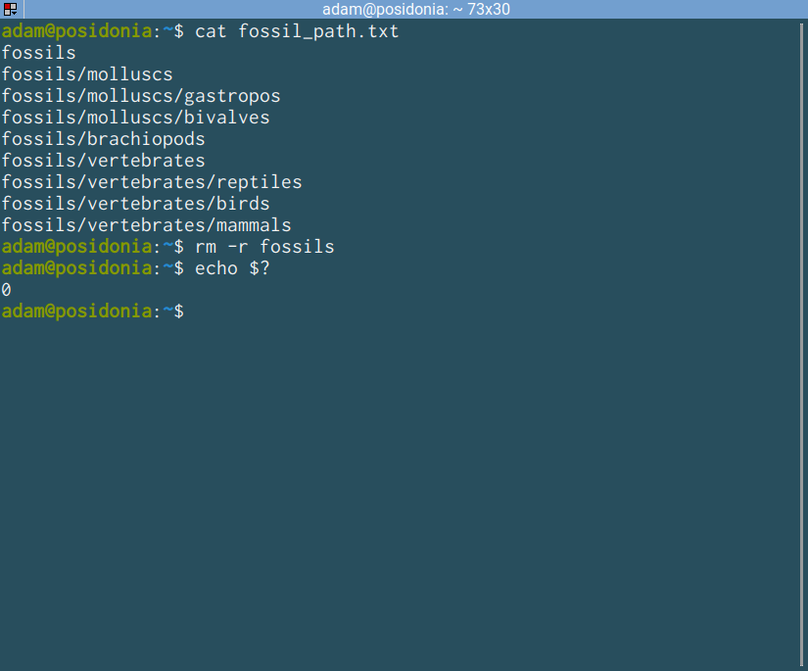
echo⎵<text>
Print something
Used to print things to the console (standard output)
$? Is a special symbol: the exit code of the last command:
0: Success
Other: Failure
https://www.redhat.com/sysadmin/exit-codes-demystified

Slide 44





Recreate the structure!
Hint 1. Use a general-purpose text editor!
Did you type things into the console?!
Novice-friendly:
Sublime Text
VS Code
Atom
Expert-friendly:
Vim
Emacs
fossils
molluscs
brachiopods
vertebrates
gastropods
bivalves
reptiles
birds
mammals

Slide 45
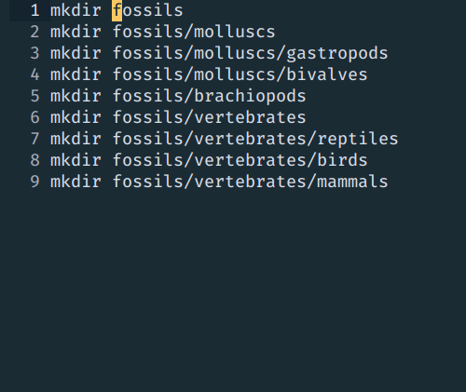
Solution 2
Hint 2. we can use the contents of fossil_path.txt
Using the same reference directory
Add mkdir in front of every line, then copy and paste into the console!
fossils
molluscs
brachiopods
vertebrates
gastropods
bivalves
reptiles
birds
mammals

Slide 46
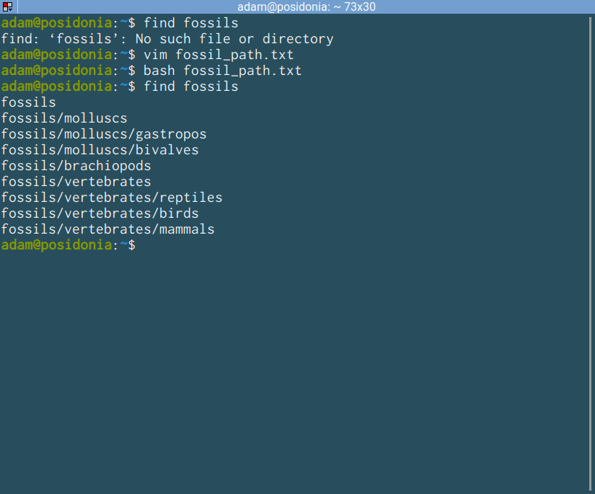
bash⎵<path>
directory not present
Executing shell scripts
adding ‘mkdir’ to previous file
The text we created is actually a shell script
The “bash” console application program can be used to execute it.
execute file as bash script
Show results
https://www.redhat.com/sysadmin/exit-codes-demystified

Slide 47
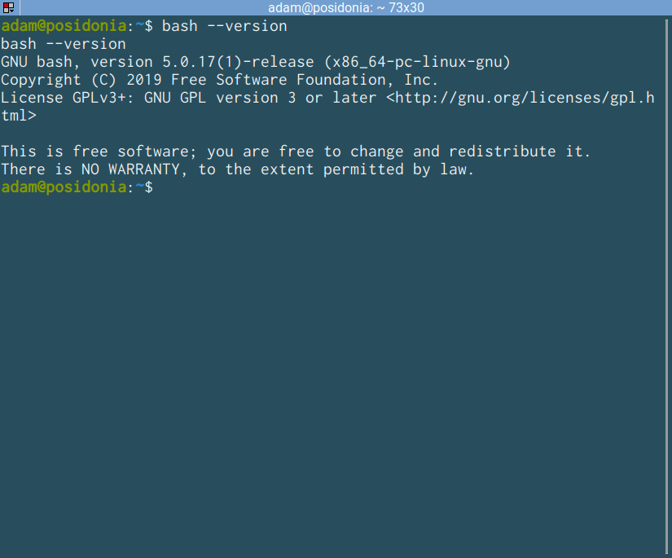
bash⎵--version
Running console applications
--version: ask for program version
--help: display help for program

Slide 48
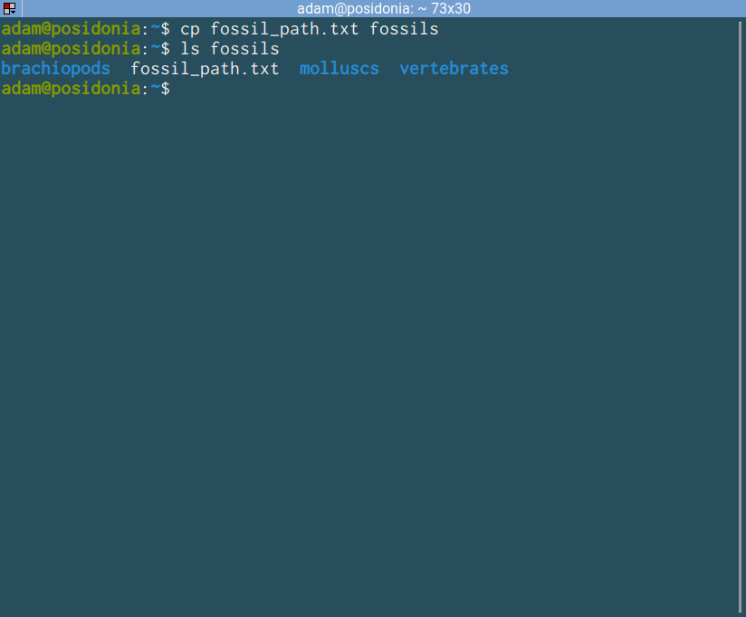
cp⎵<what>⎵<where>
Copying a file or directory
List contents of path!
New file
Target directory or file
If directory, the file will be put into it
Parent (whatever)
One of the tools that we looked at can be used to delete the file that we have created. Try to delete it!
fossils
fossil_path.txt
molluscs
brachiopods
vertebrates
fossil_path.txt

Slide 49
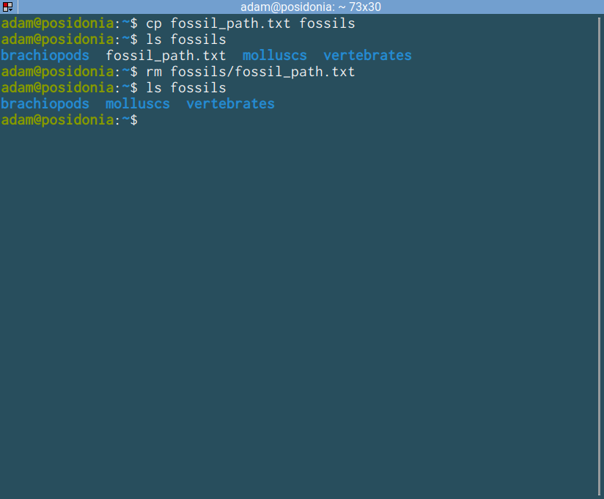
rm⎵<path_file>
Without –r removes a single file
As with cp, multiple files can be passed to this (separated by spaces)
File disappeared
Parent (whatever)
fossils
fossil_path.txt
molluscs
brachiopods
vertebrates
fossil_path.txt

Slide 50
Exercise!
Use an echo statement to write the genus name “Lingula” into fossils/brachiopods/genera.txt!
Then change directory to brachiopods.
fossils
molluscs
brachiopods
vertebrates
gastropods
bivalves
genera.txt
reptiles
birds
mammals

Slide 51
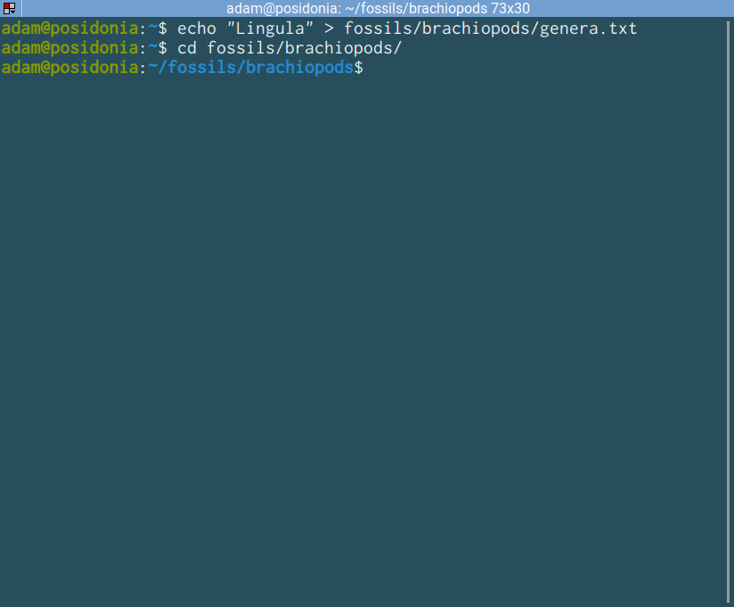
echo⎵“Lingula”⎵>⎵fossils/brachiopods/genera.txt
You can use the double chevron >> to append to an existing file

Slide 52
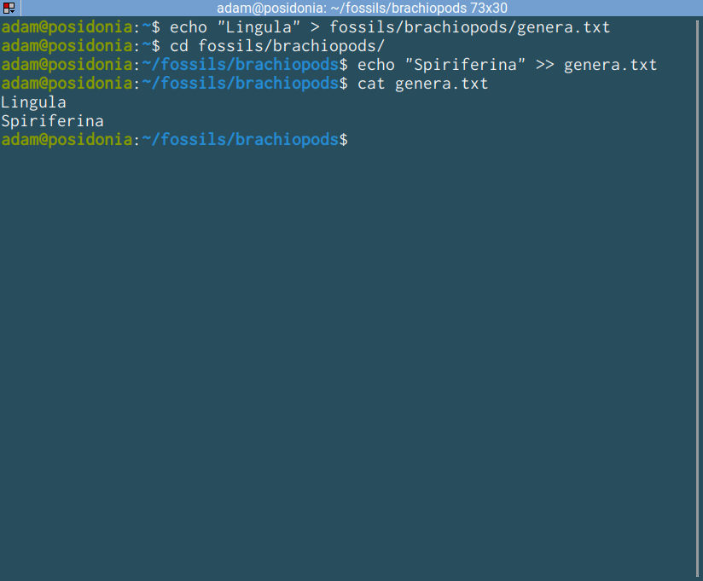
echo⎵“Spiriferina”⎵>>⎵genera.txt
Appending to files
You can use the double chevron >> to append to an existing file
Added to new line!

Slide 53
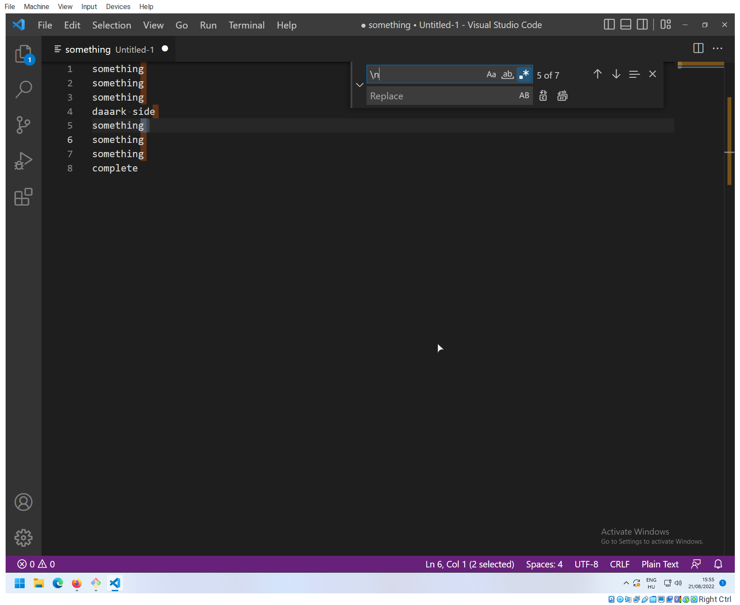
Special characters
We use so called “escape characters to denote special symbols, that sometimes have other meanings.
\n: newline escape
\t : tab escape
\” : double quote escape
\’ : single quote escape
\n
Turn on regex
Edit/Replace
Escape characters highlighted!

Slide 54
Exercise!
Use an echo statement to write the genus name “Terebratula” and “Athyris” into fossils/brachiopods/genera.txt, use a newline escape between them!
Then change directory to brachiopods.
fossils
molluscs
brachiopods
vertebrates
gastropods
bivalves
genera.txt
reptiles
birds
mammals

Slide 55
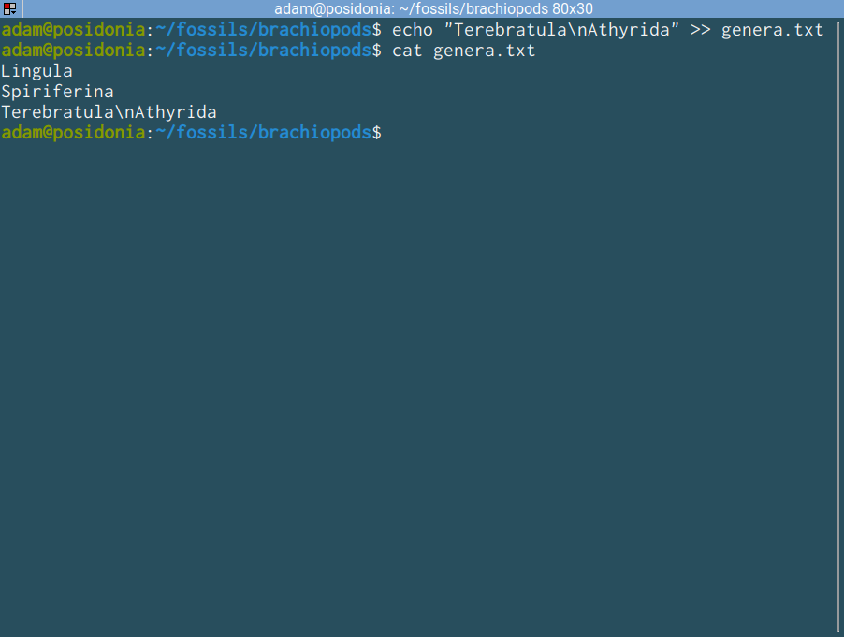
echo⎵”Terebratula\nAthyrida”⎵>>⎵genera.txt
Appending to files
It doesn’t seem to work!
Echo needs to know to replace the combination \n with the newline character!
This is not ok!

Slide 56
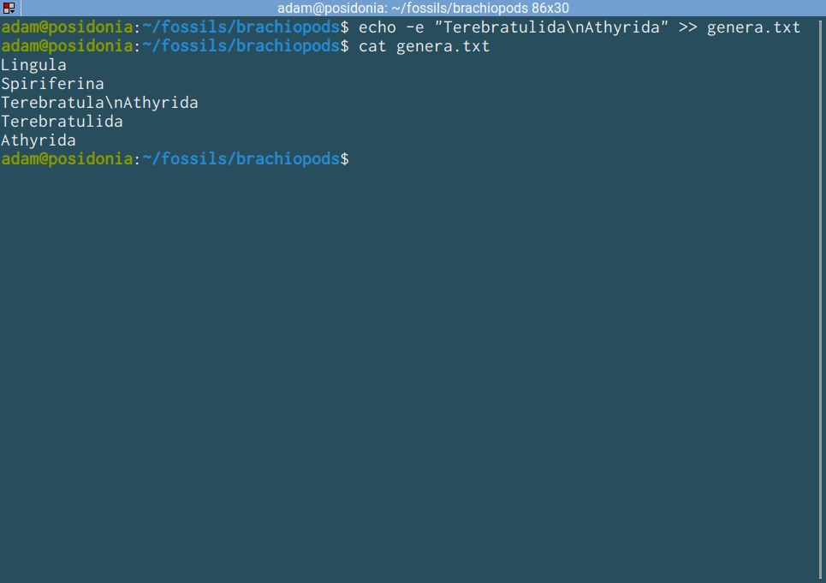
echo⎵-e⎵“Terebratula\nAthyrida”⎵>>⎵genera.txt
Appending to files
Use the –e option!
Our file is messed up. Options:
1. Redo our file
2. Use an editor to correct
Delete the bad line!
Better, next time: go back in time.
But this is still not
Now this is correct!

Slide 57
Basic version control with Git
and GitHub

Slide 58


Why version control?
Projects evolve in a non-linear way, especially programming projects.
Multiple people work on them, sometimes at the same time
Recording the history of project development
Working with many files
Sharing code is necessary, we also need to know who changes what

Slide 59

Difference between Git and GitHub?
git
GitHub and GitLab
Locally running application
Operates with files in a local directory (repository)
Works without a remotes!
Remote servers with copies of the repository

Slide 60
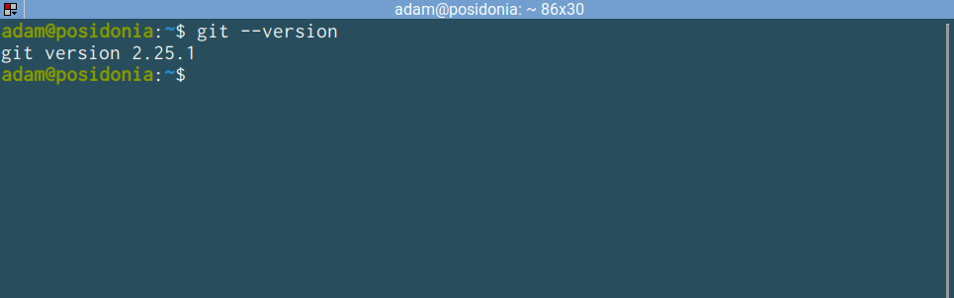
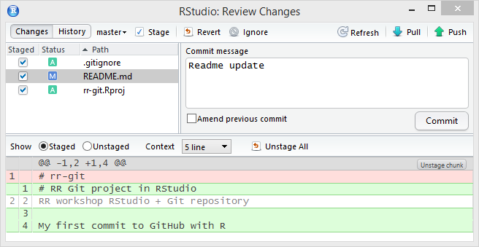
Interfaces to git
Git is a command line (console application)
The complete features are only available via the command line!
Simplified graphical interfaces written for novices, embedded in IDEs
These actually just translate the actions to the command line application -> Experiment!

Slide 61
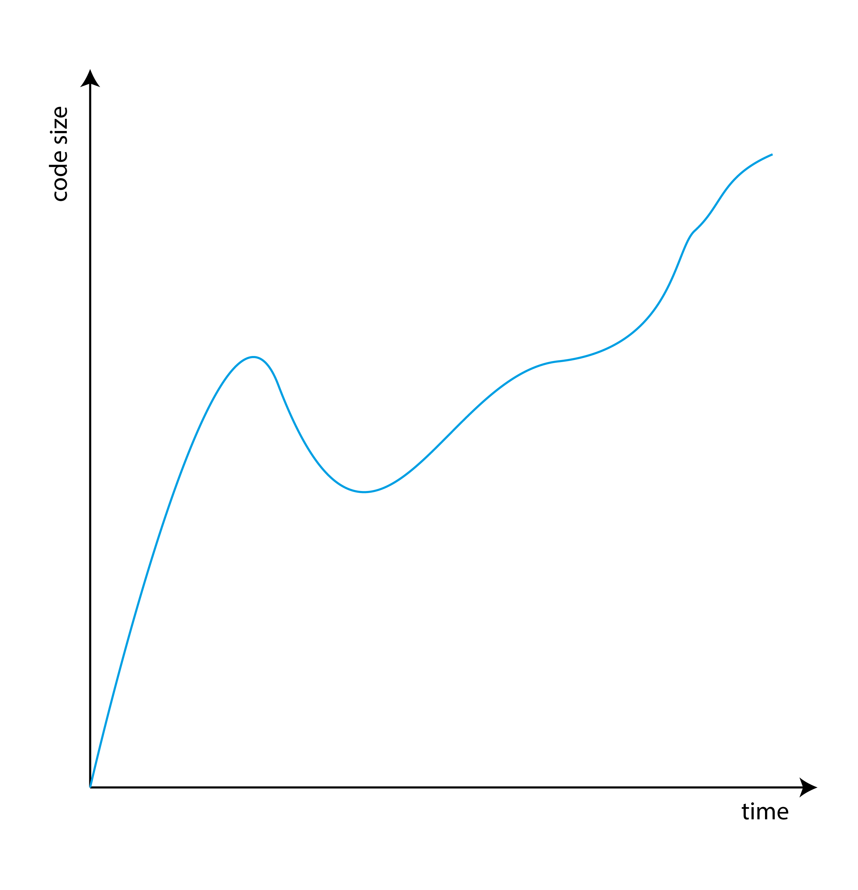
The basic use of git
Record snapshots of how a project develops.
Code develops in a non-linear, but continuous way, with lots of small changes:
Contents of files change
New files are added to the repository
Old files are delete from the respository

Slide 62
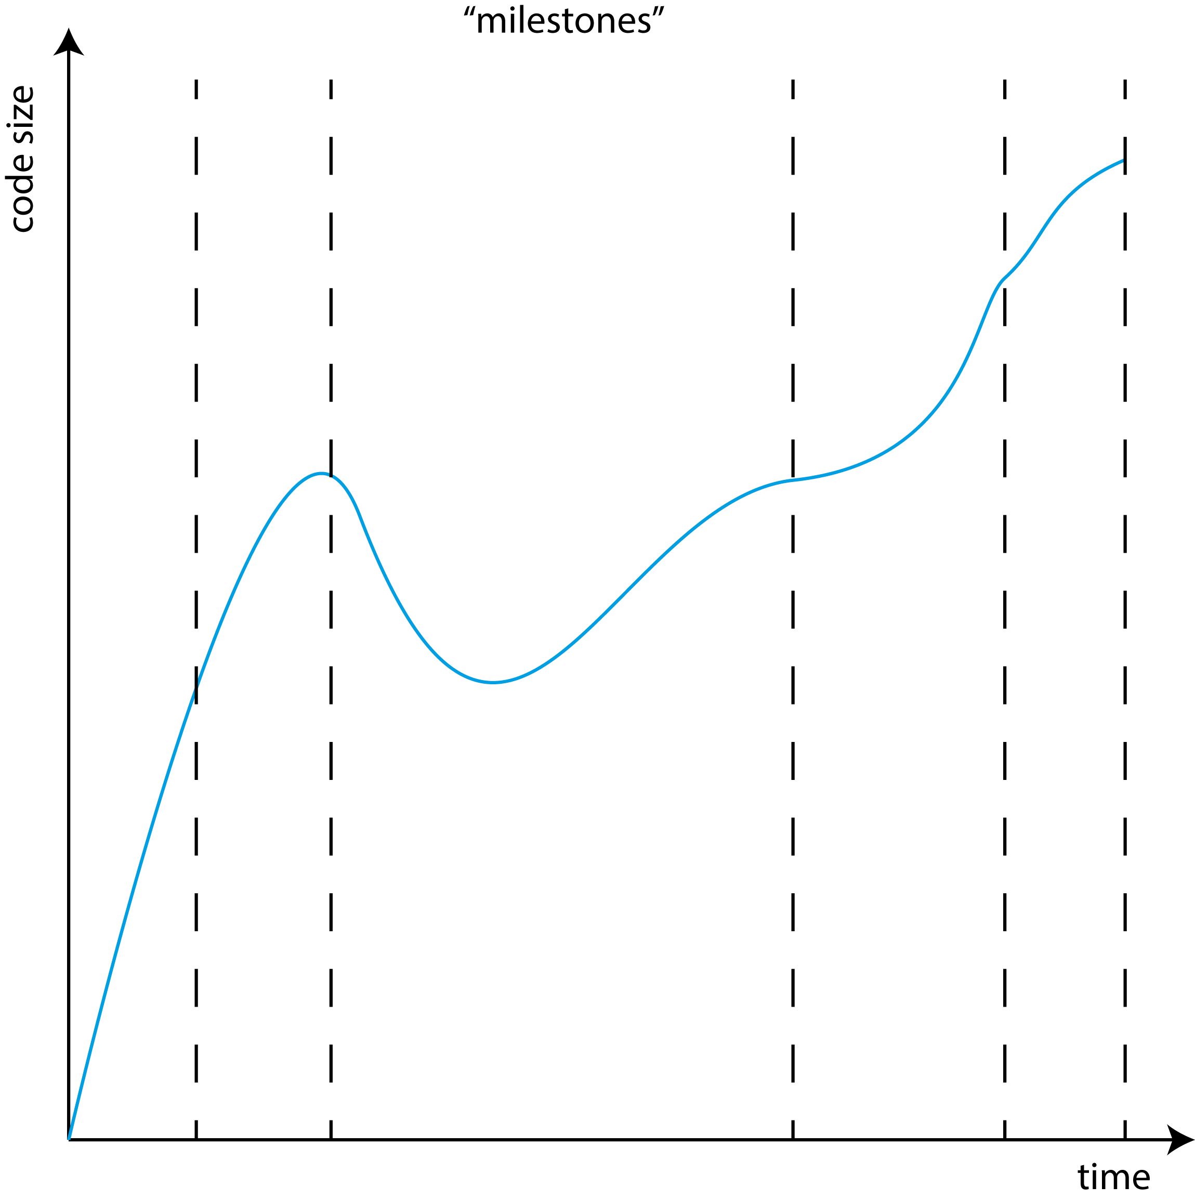
The basic use of git
Record snapshots of how a project develops.
Specific states of the code represent milestones:
Something works completely
Everything is cleaned up
Ready for further development
In between these are transient states, when you are working on something but that is not yet done.

Slide 63
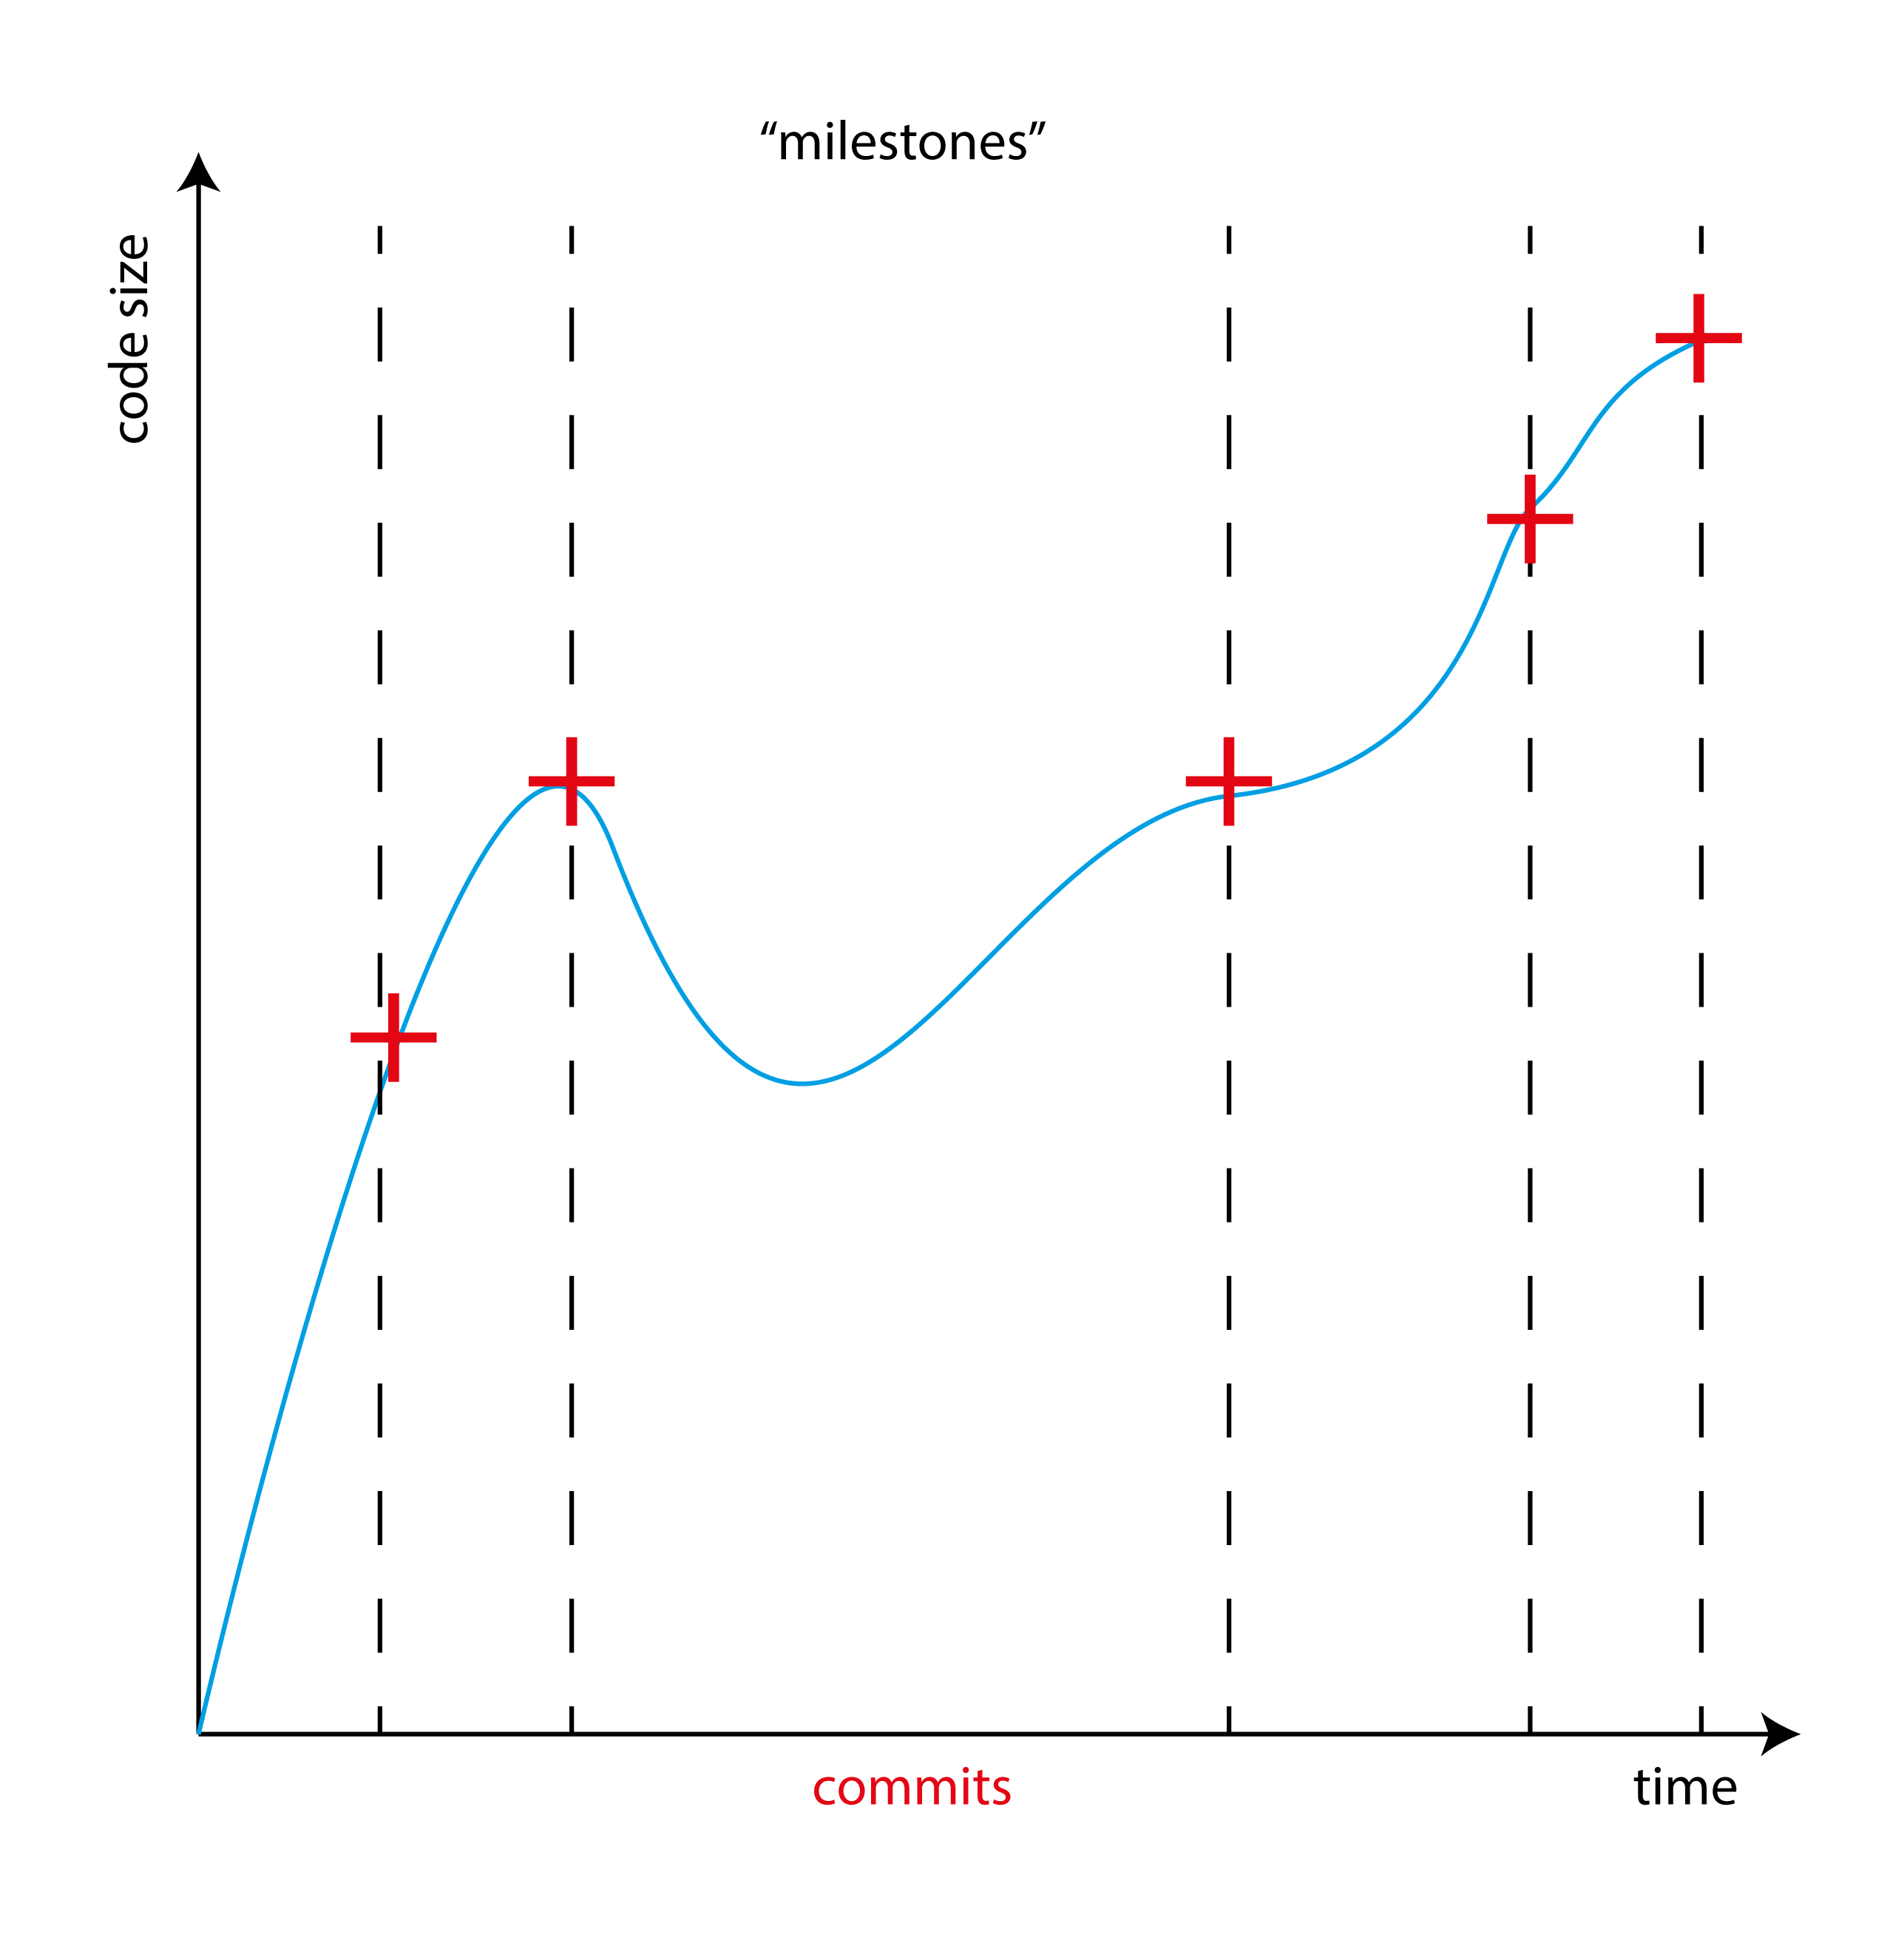
The basic use of git
Record snapshots of how a project develops.
These milesones can be saved and accessed at any time.
These states are called as ‘commits’ in git’s terminology

Slide 64
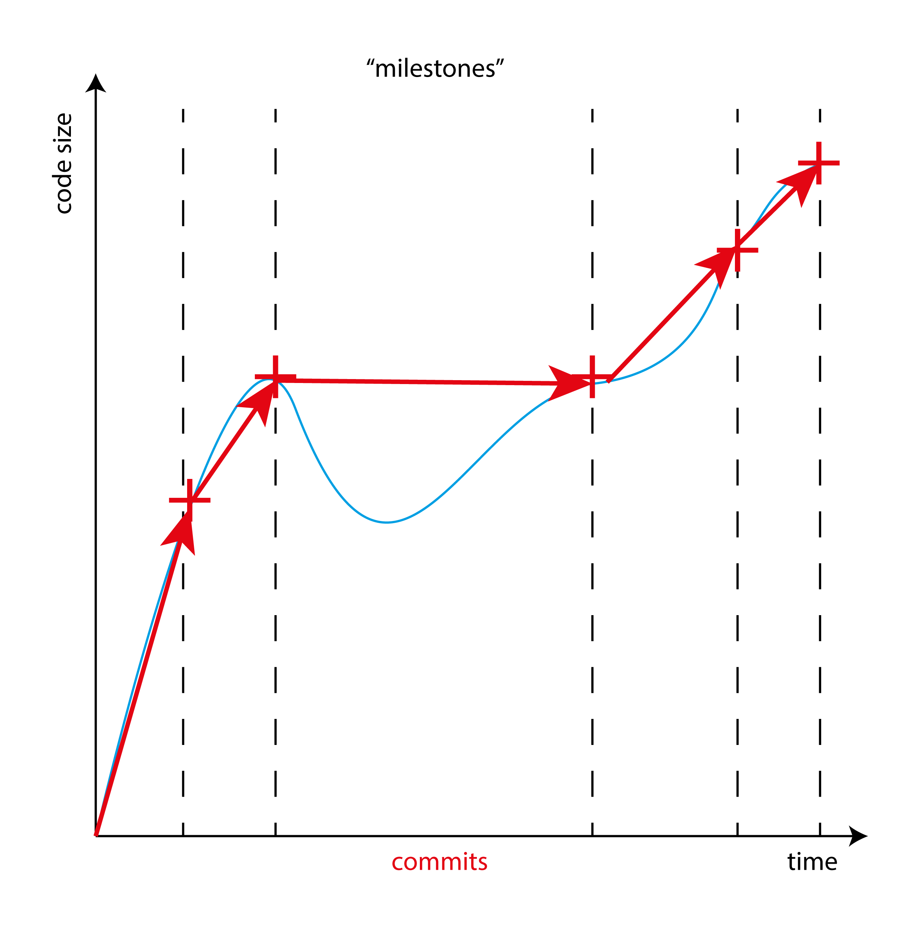
The basic use of git
Record snapshots of how a project develops.
Only the committed stages are recorded, the rest of the history is discarded
The git repository is recorded as changes from one commit to the next

Slide 65
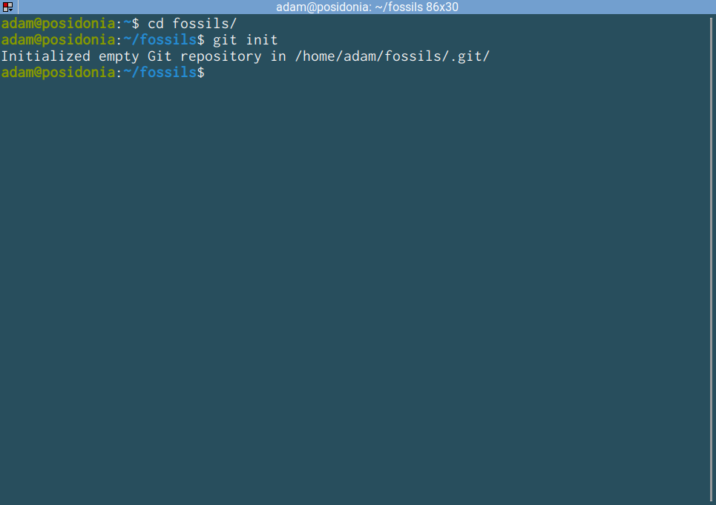
git⎵init
Name of application
Command for the application
Create a new git repository in current directory.
A git repository is a directory with git metadata in it.
The git metadata are in the .git directory
Creates the .git metadata
.name always refers to hidden items!

Slide 66
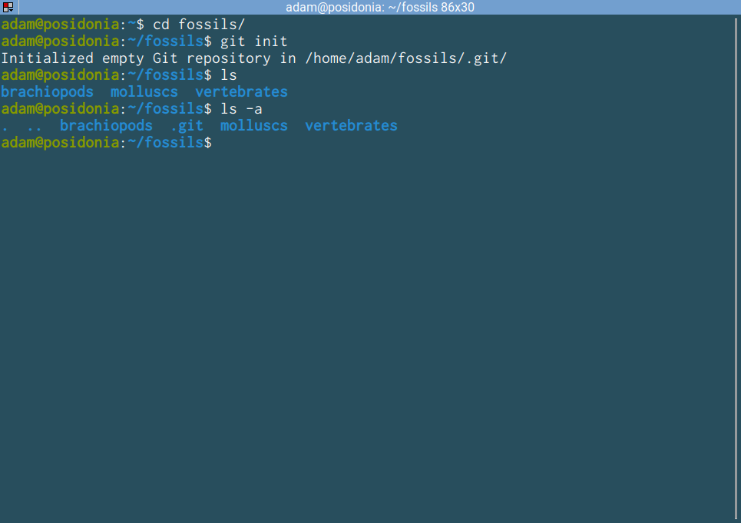
ls⎵-a
List all files and directories in directory, including hidden items!
The double dot (..) represents a way to refer to the previous directory, as we have seen earlier
The single dot (.) represents a way to refer to the current directory.
Note: cd brachiopods and cd ./brachiopods are the same!
the .git metadata directory
‘Virtual’ directories . (dot) and .. (dot dot)

Slide 67
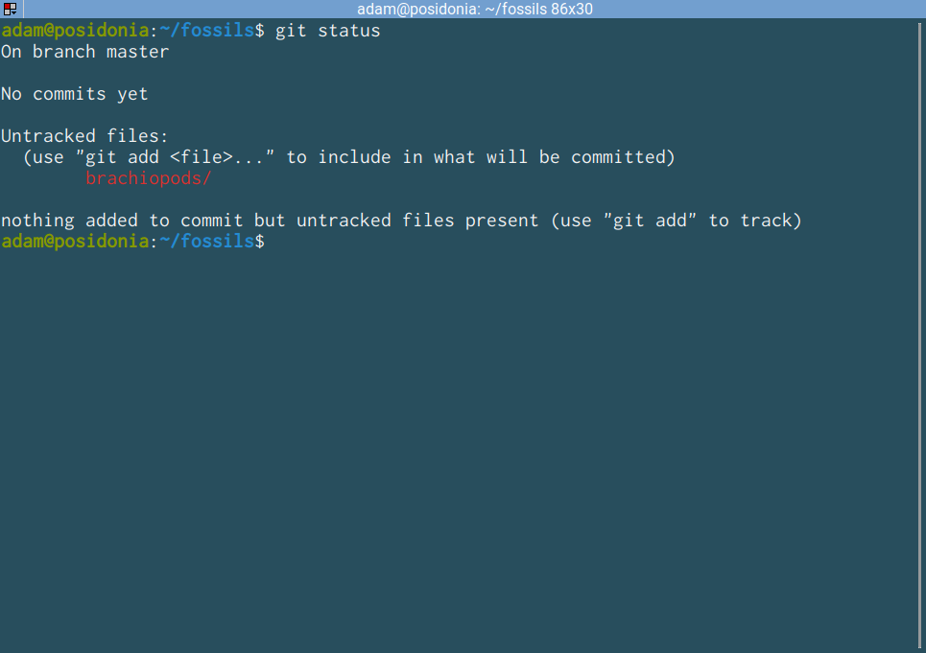
git⎵status
Name of application
Command for the application
Name of the current “branch”
Show the status of the current respository
We have no commits yet
A series of commits is called a ‘branch’. Simple repos use only one. There is always a current one
Git has detected that there are things in the repo that are not registered.
Git can only detect files. Empty directories are not recorded!
NOTE: In many cases, git literally tells you what to do.

Slide 68
Staging
The preparation of a commit
Commits are permanent, or are difficult to remove once done, so we have tools to make sure that they are ok
Changes first have to be staged, before commiting. This allows us to include only specific changes in the commit, and to make sure that we are doing things ok.

Slide 69



Staging and commit (Airport)
Getting staged
Initial boarding pass control vs. boarding
If you go through security you are staged to fly. You are expected to be on the plane, but you can still leave.
If you board the plane and the cabin doors are closed, you are committed to a flight.
In the staged area, waiting to be commited
The commit

Slide 70
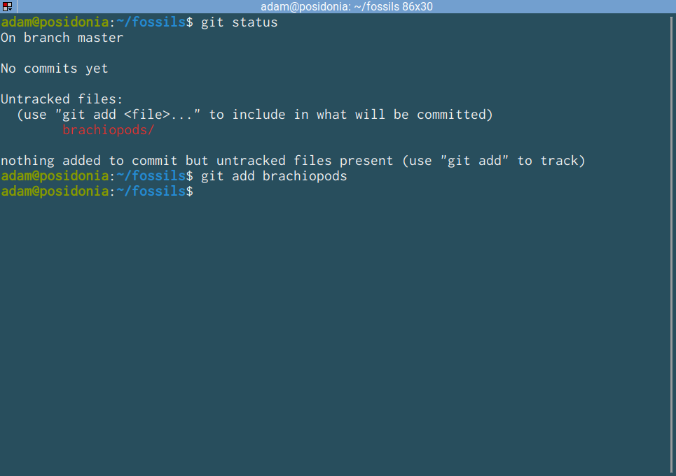
git⎵add⎵<path>
Name of application
Command for the application
Stage the target file or directory.
Frequently this is an entire directory, including . (dot)
If successful does not return anything, has to be checked with git status

Slide 71
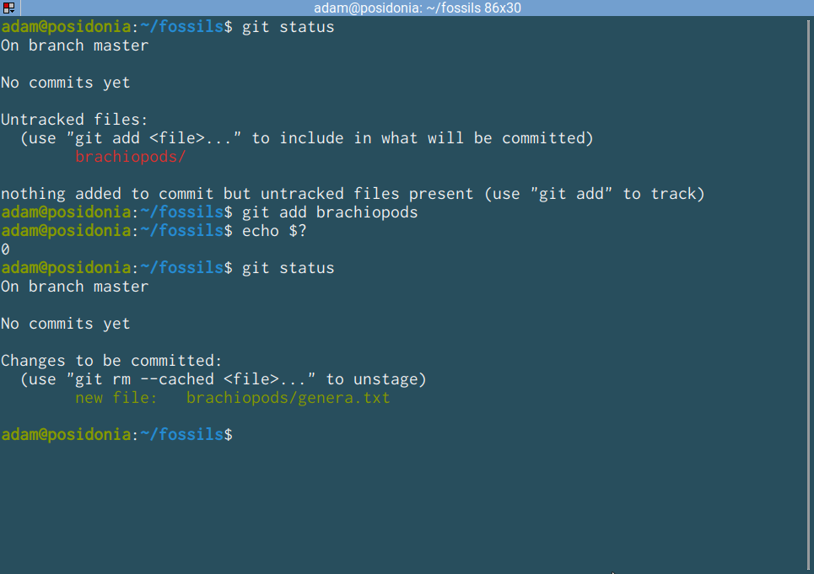
git⎵status (again)
Show status of repo
Things really went error free (not necessary to check)
There is just one file here which git finds.
The file is now stages to be commited.
If you have changed your mind, do what git tells you!

Slide 72
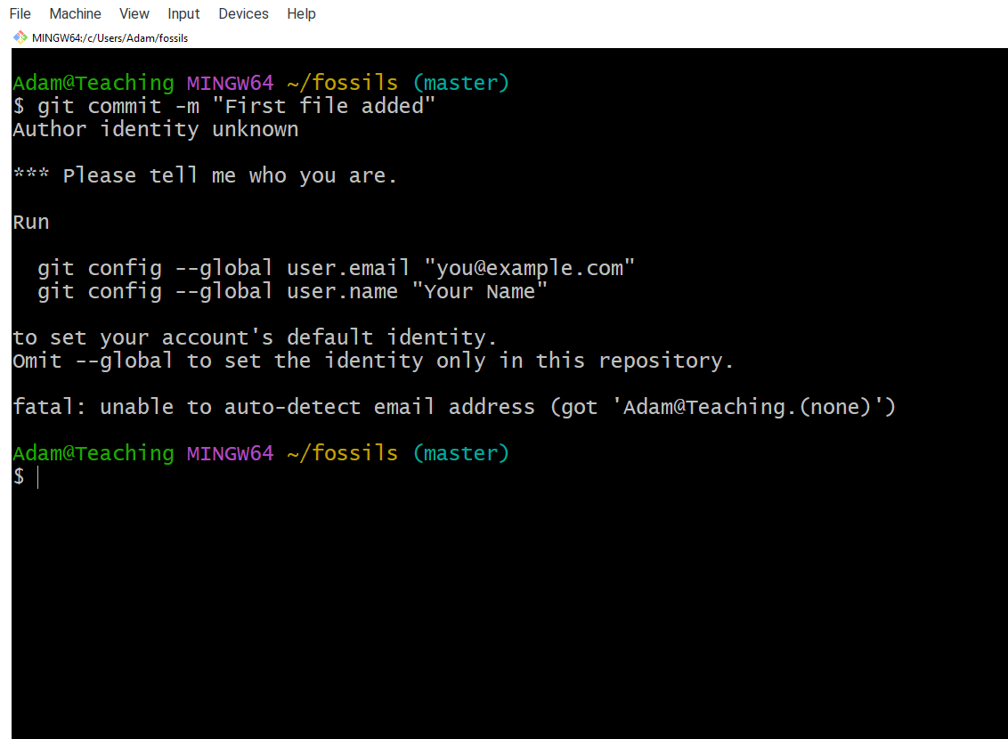
git⎵commit⎵-m⎵<message>
First use not permitted without credentials!
You need to provide a user name and an email address with the git config command

Slide 73

git⎵config⎵--global⎵<what>⎵<value>
Configuring git
user.name and user.email
--global sets this for all your local git repositories
Now you are ready to commit

Slide 74

git⎵commit⎵-m⎵<message>
The message you provided
The beginning of the hash of the commit.
Now create a new commit
Four new lines are added
Provide a message in quotes! This is the human readable description of what changed.
Every commit gets a unique ‘hash’, a random set of characters that are used to identify unambiguously identify the commit
branch
The affected files

Slide 75

git⎵status (yet again)
Nothing to be done.
Create two new files

Slide 76
Exercise!
Create a new file genera.txt in the mammals directory, and put the names of 3 mammalian genera in it!
Stage and commit the changes!
fossils
molluscs
brachiopods
vertebrates
gastropods
bivalves
genera.txt
reptiles
birds
mammals
genera.txt

Slide 77

My solution
Contents of the new file
Add everything you find in current directory.

Slide 78
Exercise!
Create a new file genera.txt in the birds directory, and put the names of 2 bird genera in it!
Add another genus to the mammals.
Try to commit only the birds!
fossils
molluscs
brachiopods
vertebrates
gastropods
bivalves
genera.txt
reptiles
birds
mammals
genera.txt

Slide 79

My solution
Add birds
1. Make the changes.
Added another mamal
Change in already committed file
New entries to be added

Slide 80

My solution
2. Stage only the birds.
Staged.
Not staged!

Slide 81

My solution
3. Stage only the birds.
Nothing happened to mammals!

Slide 82

git⎵restore⎵<path>
Again, git literally tells you your options
Discarding changes from previous commit
We can commit the new mammal or discard it.
You can correct unintended changes with this.
What about even older changes?
The file is restored to the state before the changes, what is in the commit.

Slide 83
GitHub
and GitHub

Slide 84
GitHub
Where the world builds software (2008-)
Open source software development platform, places to store and share git repositories
Currently owned by Microsoft
Applications, packages, plugins, webpages and many more!
Free and private repositories.

Slide 85


GitHub
Sign up if you haven’t yet!

Slide 86

GitHub - Dashboard
Notifications
Settings
Notifications

Slide 87

GitHub - Dashboard
Access you repos
Settings

Slide 88

GitHub – Creating a new repo
Make a new repo

Slide 89

GitHub – Creating a new repo
Usually the same as the local directory.
Do not change these. You will copy files over from your local repo.
Things for others!
Create!

Slide 90

GitHub – The fresh empty repo
We have already done this mostly
This is what you want
Mac Users
Can only use ssh to authenticate!

Slide 91
GitHub – Add new remote
The name of the new remote. You can refer to it from now on using this name!
Command: you want to make changes of how your local repository is connected to remotes
You are registering a new remote
Application name
The URL of the remote. This is used to identify the remote on the web.

Slide 92
GitHub – Rename current branch to main
Move all contents of current branch to
The name of the branch (new)
Application name
Command: you want to do things with branches
For political reasons, GitHub does not allow the use of the name master, hence this extra step.

Slide 93
GitHub – Pushing contents of branch to remote
Application name
Command: you want copy contents from local to remote
Set the default remote and branch
Remote to copy material to
Which branch to push?
GitHub will ask for your credentials

Slide 94

GitHub – Executing this and signing in on windows
Note branch name change
Most interactive sign in option available on Windows

Slide 95


GitHub – Executing this and signing in on windows
This is what you want

Slide 96

GitHub – Successful push
Transfer stats
New branch main is created on remote
And is now in sync with local

Slide 97

GitHub – Successful push
A Readme is quite useful

Slide 98

Writing a Readme
Default format is markdown (later)
You can work on files using GitHub’s interface
Save the defaults, by clicking on the green button
Note that you are technically creating a new commit!
File name: .md is for markdown.
Some default content, we will visit this again.
Default commit message.

Slide 99

GitHub – Changing the remote
The very last commit’s hash
The message of the last commit that modified the file
Readme file now added!
Beautifully rendered markdown document

Slide 100

git⎵pull⎵<remote>⎵<branch>
Pull changes from remote
Just because you changed something on the remote server does not make things magically appear locally
You have to pull the contents of the remote to have the new file that you just created!

